Slide 1
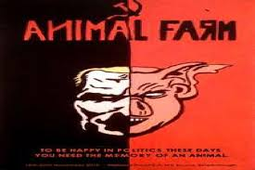
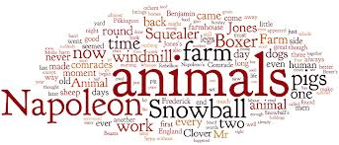
Animal Farm Introduction: Time Period and Relevant Historical Factors

Slide 2
Things to think about…
Orwell wrote this powerful novel in an attempt to make people aware of what was truly happening around them.
He wanted people to stand for something better, a better way of life.
He felt that if he did not do something to awaken his fellow members of society against the uprising of totalitarian governments then individuals will lose whatever amount of control they have, not only over their lives but the lives of the future generations.
His novel is still a piece of powerful literature today.

Slide 3
Democracy smecrocacy…what’s the big deal?
In America, we live in a democracy. To many that is a wonderful thing. To many, they do not know or understand what it is like to live in such a nation.
Using the following websites, read and learn about the different types of government.
http://news.bbc.co.uk/cbbcnews/hi/find_out/guides/world/united_nations/types_of_government/newsid_2151000/2151570.stm
After reading, complete the following activities:
A. Define totalitarianism, fascism, Nazism, democracy, communism, dictatorship
B. How does democracy compare to the other types of government?
C. What would America be like today if we were suddenly made to become a totalitarian country instead of a democracy?

Slide 4
Strap yourself in and get ready to travel to a world not so long ago!
Using the following websites below, read about Stalin.
http://www.bbc.co.uk/history/historic_figures/stalin_joseph.shtml
http://www.sparknotes.com/biography/stalin/section10.rhtml
After reading, answer the following questions:
A. After WWII, people’s hopes began to rise. What was Stalin’s fear? Was his fear justified? Why or why not?
B. Imagined atrocities supposedly committed by the Americans began to appear in the newspapers. Why was such a thing done? What does that indicate pertaining to Stalin’s hold over his people?
C. It was said that Stalin had an “unlimited will of power.” What does that statement mean?
D. Describe the Great Purge? What was the purpose? Could such a thing be done today in America? Explain your answer.

Slide 5
Define the following words:
Satire
Allegory
Irony
Fable

Slide 6
Fairytales and all their glory..
Read one of the following fairytales. (I know you know most of them, but there are things I am going to ask you to do for them… so read only one!)
“Cinderella” or “Sleeping Beauty”
Make a list of the elements (special words, setting ,types of characters, Magic , problem or conflict ) of the fairy tale and the their examples from the tales..

Slide 7
Things You Will Need to do for the Novel..
Take notes per chapter . This will serve as your summary for your test.
Make a character chart for each of the following characters. Be sure to leave enough room to allow you to add details from the book;
Mr. Jones, Old Major, Napoleon, Snowball, Moses the raven, Mollie, Benjamin, the cat, the sheep, Mr. Pilkington, Fredrick, the dogs, Squealer, Minimus, Mr. Whymper, Boxer, Clover

