Slide 1
Cask of Amontillado
Background

Slide 2
Catacombs
Catacombs are underground burial vaults.
An underground cemetery consisting of chambers or tunnels with recesses for graves.
An underground, often labyrinthine (very confusing tunnels…like a maze) passageway.
These are often very extensive and hard to navigate….often miles and miles and miles underground..

Slide 3
Catacombs in France

Slide 4
Catacombs in Paris

Slide 5
And more…

Slide 6
Can you guess what it says?

Slide 7
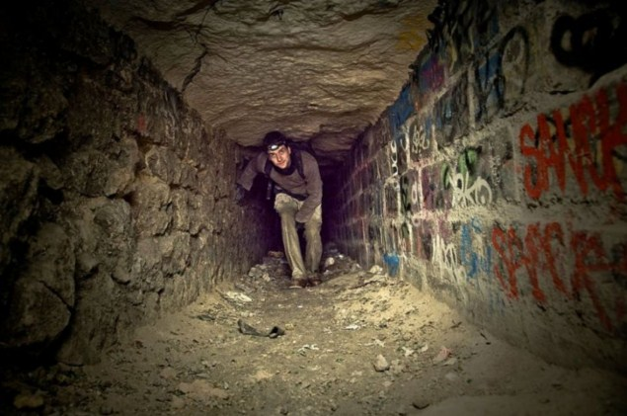
Modern Day Catacomb… just without the bodies.. ☺

Slide 8
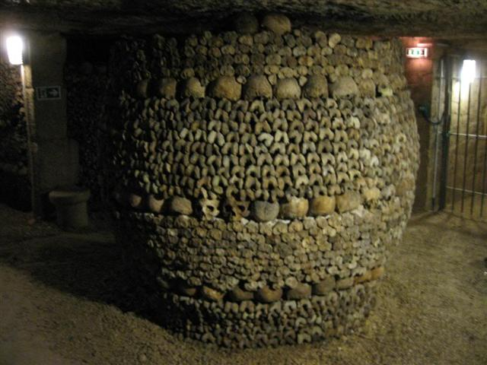
Notice the gate???

Slide 9
Okay enough with the gory stuff….
This is a pipe where wine was stored before it was brought above ground. The longer it stayed in these barrels, the longer it was able to ferment…meaning to become better with age. The older it was the more expensive it was… keep that in mind gentlemen.. ☺

Slide 10
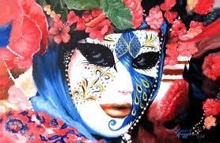
Background/Setting…..can u guess?

Slide 11
Setting
Carnival/ catacombs
.It is dusk on a day during the annual carnival celebration in an Italian city. People are eating, drinking, and making merry before the beginning of the 40-day Lenten season.

Slide 12
Look at the colors.. On what might the focus of the story be ?
Notes:
Stop here bc the next few slides are used after the story.

Slide 13
Vocabulary: See How much you know☺
Aperture. Circumvent- Fetter Flambeau. Hearken Immolate - Imposture Impunity Médoc Motley Palazzo Pipe Puncheon Rapier Rheum Roquelaure Sconce

Slide 14
Vocabulary
Aperture Opening. Circumvent- Encircling, surrounding; tracing a line around. Fetter Shackle, chain, bond. Flambeau Torch; plural, flambeaux. Hearken Listen carefully. Immolate - Kill a person as a sacrifice. Imposture Deception, fraud. Impunity Freedom from punishment; exempt from punishment. Médoc Red wine from the Bordeaux region of France. Motley Apparel of many colors; jester’s costume. Palazzo Palace; splendid home. Pipe Cask holding 126 gallons. Puncheon Cask holding 84 gallons. Rapier Two-edged sword. Rheum Watery discharge. Roquelaure Knee-length, often fur-trimmed cloak Sconce Bracket on a wall for holding a candle or a torch.

Slide 15
Themes
Revenge- Fortunato had committed many offenses against Montresor, the last one an insult, according to Montresor.
Deception- To lure Fortunato into the catacombs, Montresor deceives Fortunato, telling him he wants to taste some wine to determine whether it is genuine Amontillado.
Pride- Fortunato readily accepts Montresor's invitation to taste wine and determine whether it is genuine Amontillado, for Fortunato believes himself to be a great wine connoisseur. So proud is he of his ability that he takes on the challenge even though he has a cough and is already somewhat drunk.

Slide 16
A review…for Cask…
Here a link to a few different renditions…..I think you’ll enjoy them… ☺
http://www.youtube.com/watch?v=LBC7Rown13Q
http://www.youtube.com/watch?v=RuS2pkzy1Mk&feature=related

Slide 17
Oral reading of Cask of Amontillado
http://www.youtube.com/watch?v=5p0U1_dDO5Q&feature=related

